Slide 1
Progress on Growth Modeling
Maia Kapur PSTAT Group Call
11 Mar 2019

Slide 2
Objective of this work
Find/Develop data-driven method to ID spatial break points in growth
See if there are areas between which sablefish growth differs

Slide 3
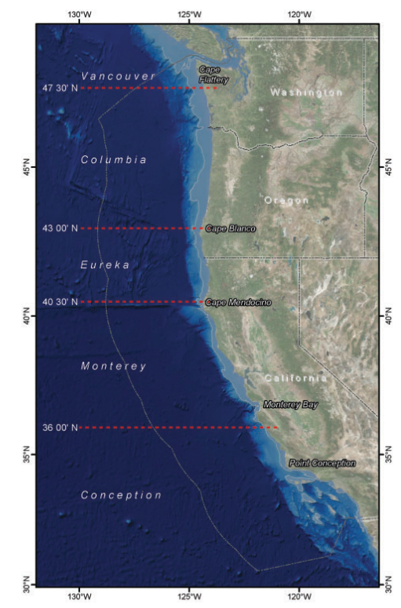
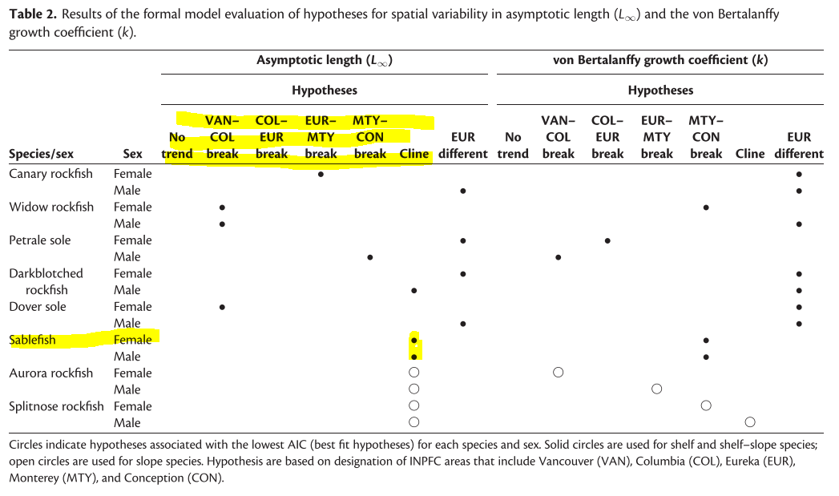
Previous work
Gertseva et al., Echave et al. – a priori breaks
Notes:
Generally pre specified

Slide 4
Other things I’ve tried/am aware of
A priori breaks – prefer data-driven
VAST – was interesting, but didn’t indicate change points, just gradients
STARS method (Roidonov ~2003 – may use as comparison)
Notes:
Generally pre specified

Slide 5

Our proposed method (in a nutshell)
“Let the data talk”
Fit a Generalized Additive Model (GAM) to a single age and sex
$$g\left(μ_{t}\right)=β_{0} +f\left(x_{t}\right)+f\left(s_{t}\right)+ε_{t}$$
$$length=intercept +smoother(year)+smoother(latitude)+ε_{t}$$
Evaluate 1st derivative of the latitude smoother to see where it is changing most
Notes:
Will show figures shortly

Slide 6
Simulation Testing
Does this actually work?
Built an Individual Based Model with artificially-induced spatial changes
Fish in different “regions” are subject to different life-history regimes

Slide 7
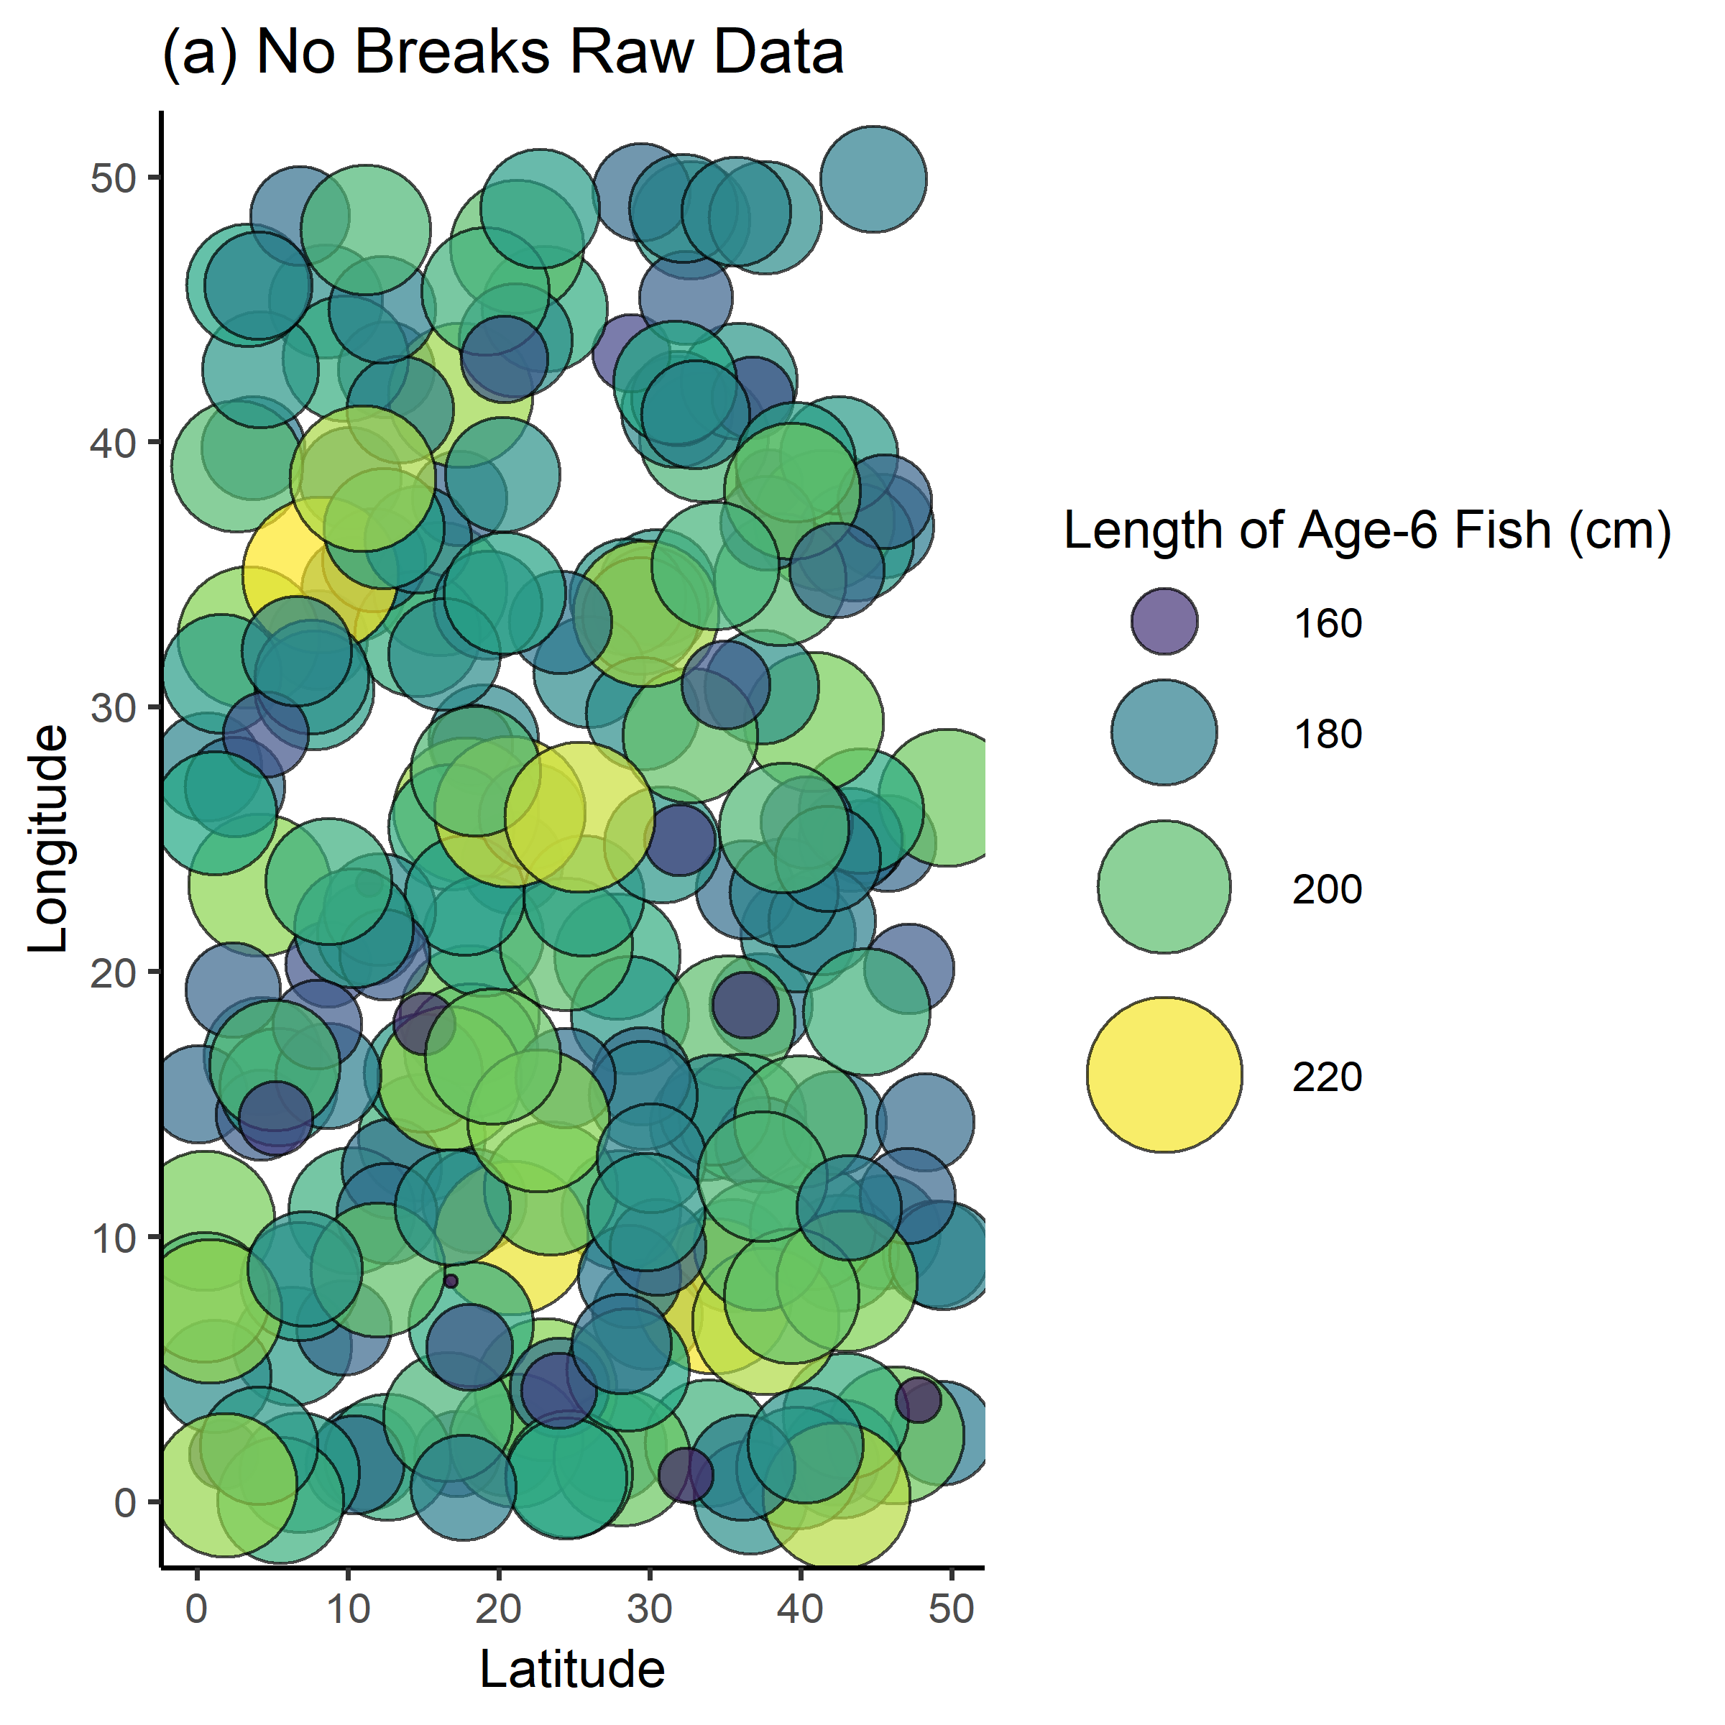
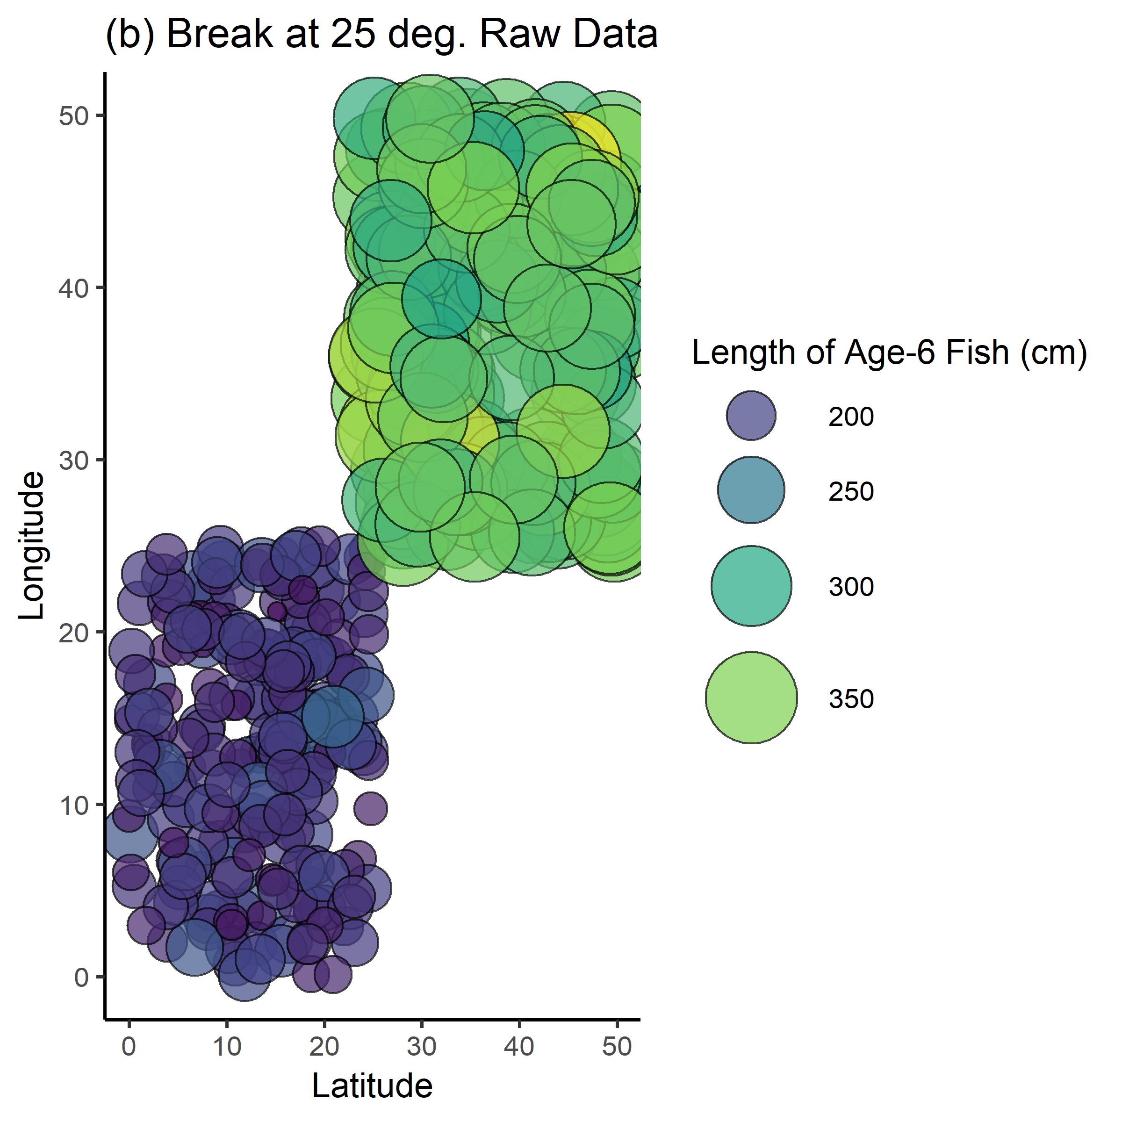
Simulation Testing

Slide 8
How the GAM analysis looks
Filter to only have single-aged fish, to avoid age effects
GAM diagnostics generally good
100 trials each for several spatial scenarios

Slide 9
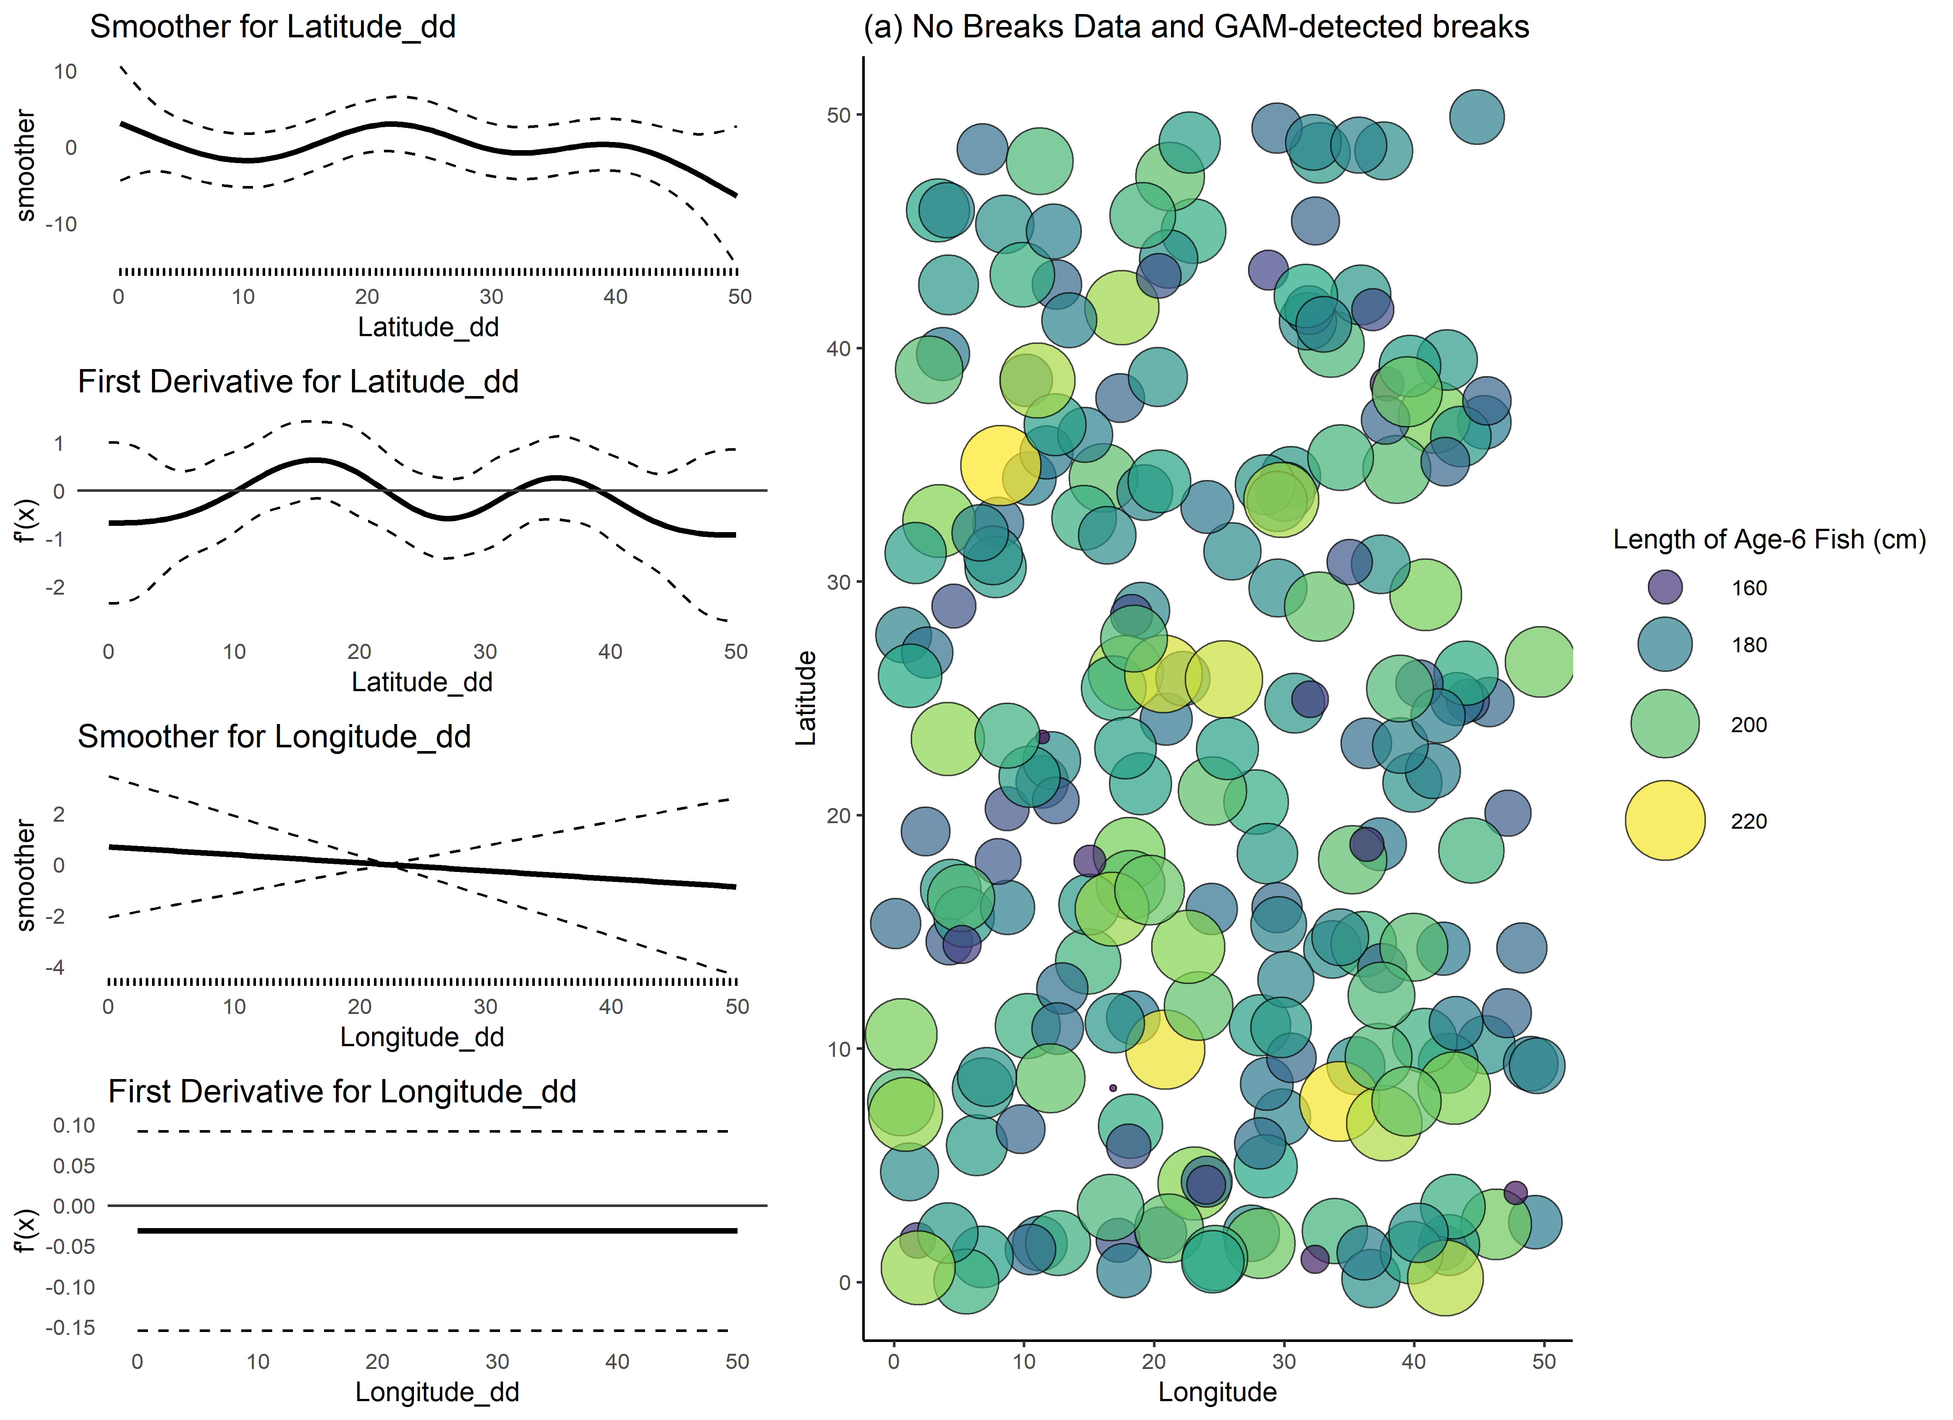
How the GAM analysis looks
No breaks identified – good!
Notes:
Walk thru the plot

Slide 10
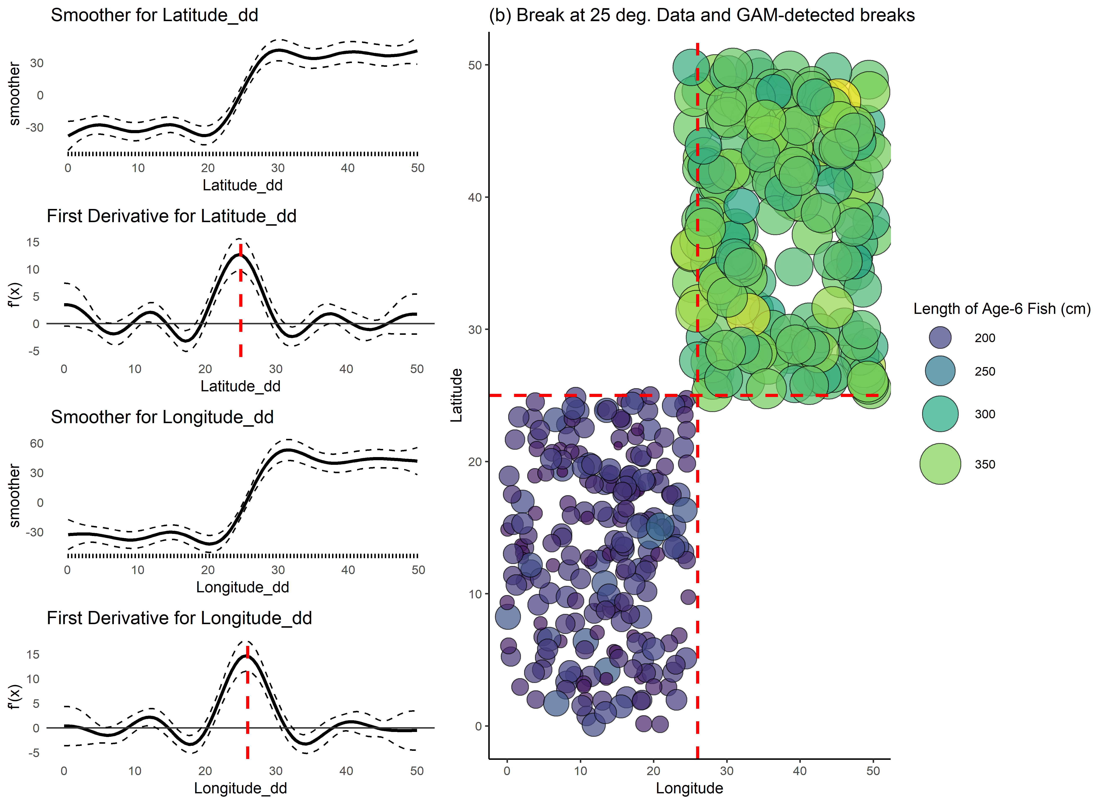
How the GAM analysis looks
Lat break @ 25, Lon break @ 26 – pretty close!

Slide 11
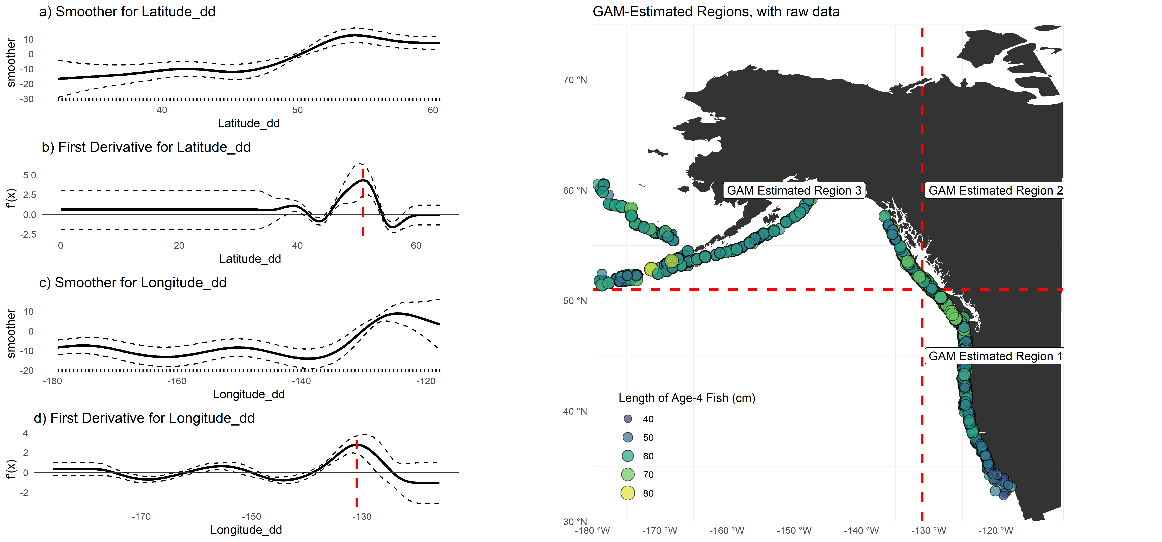
Application to Sablefish

Slide 12
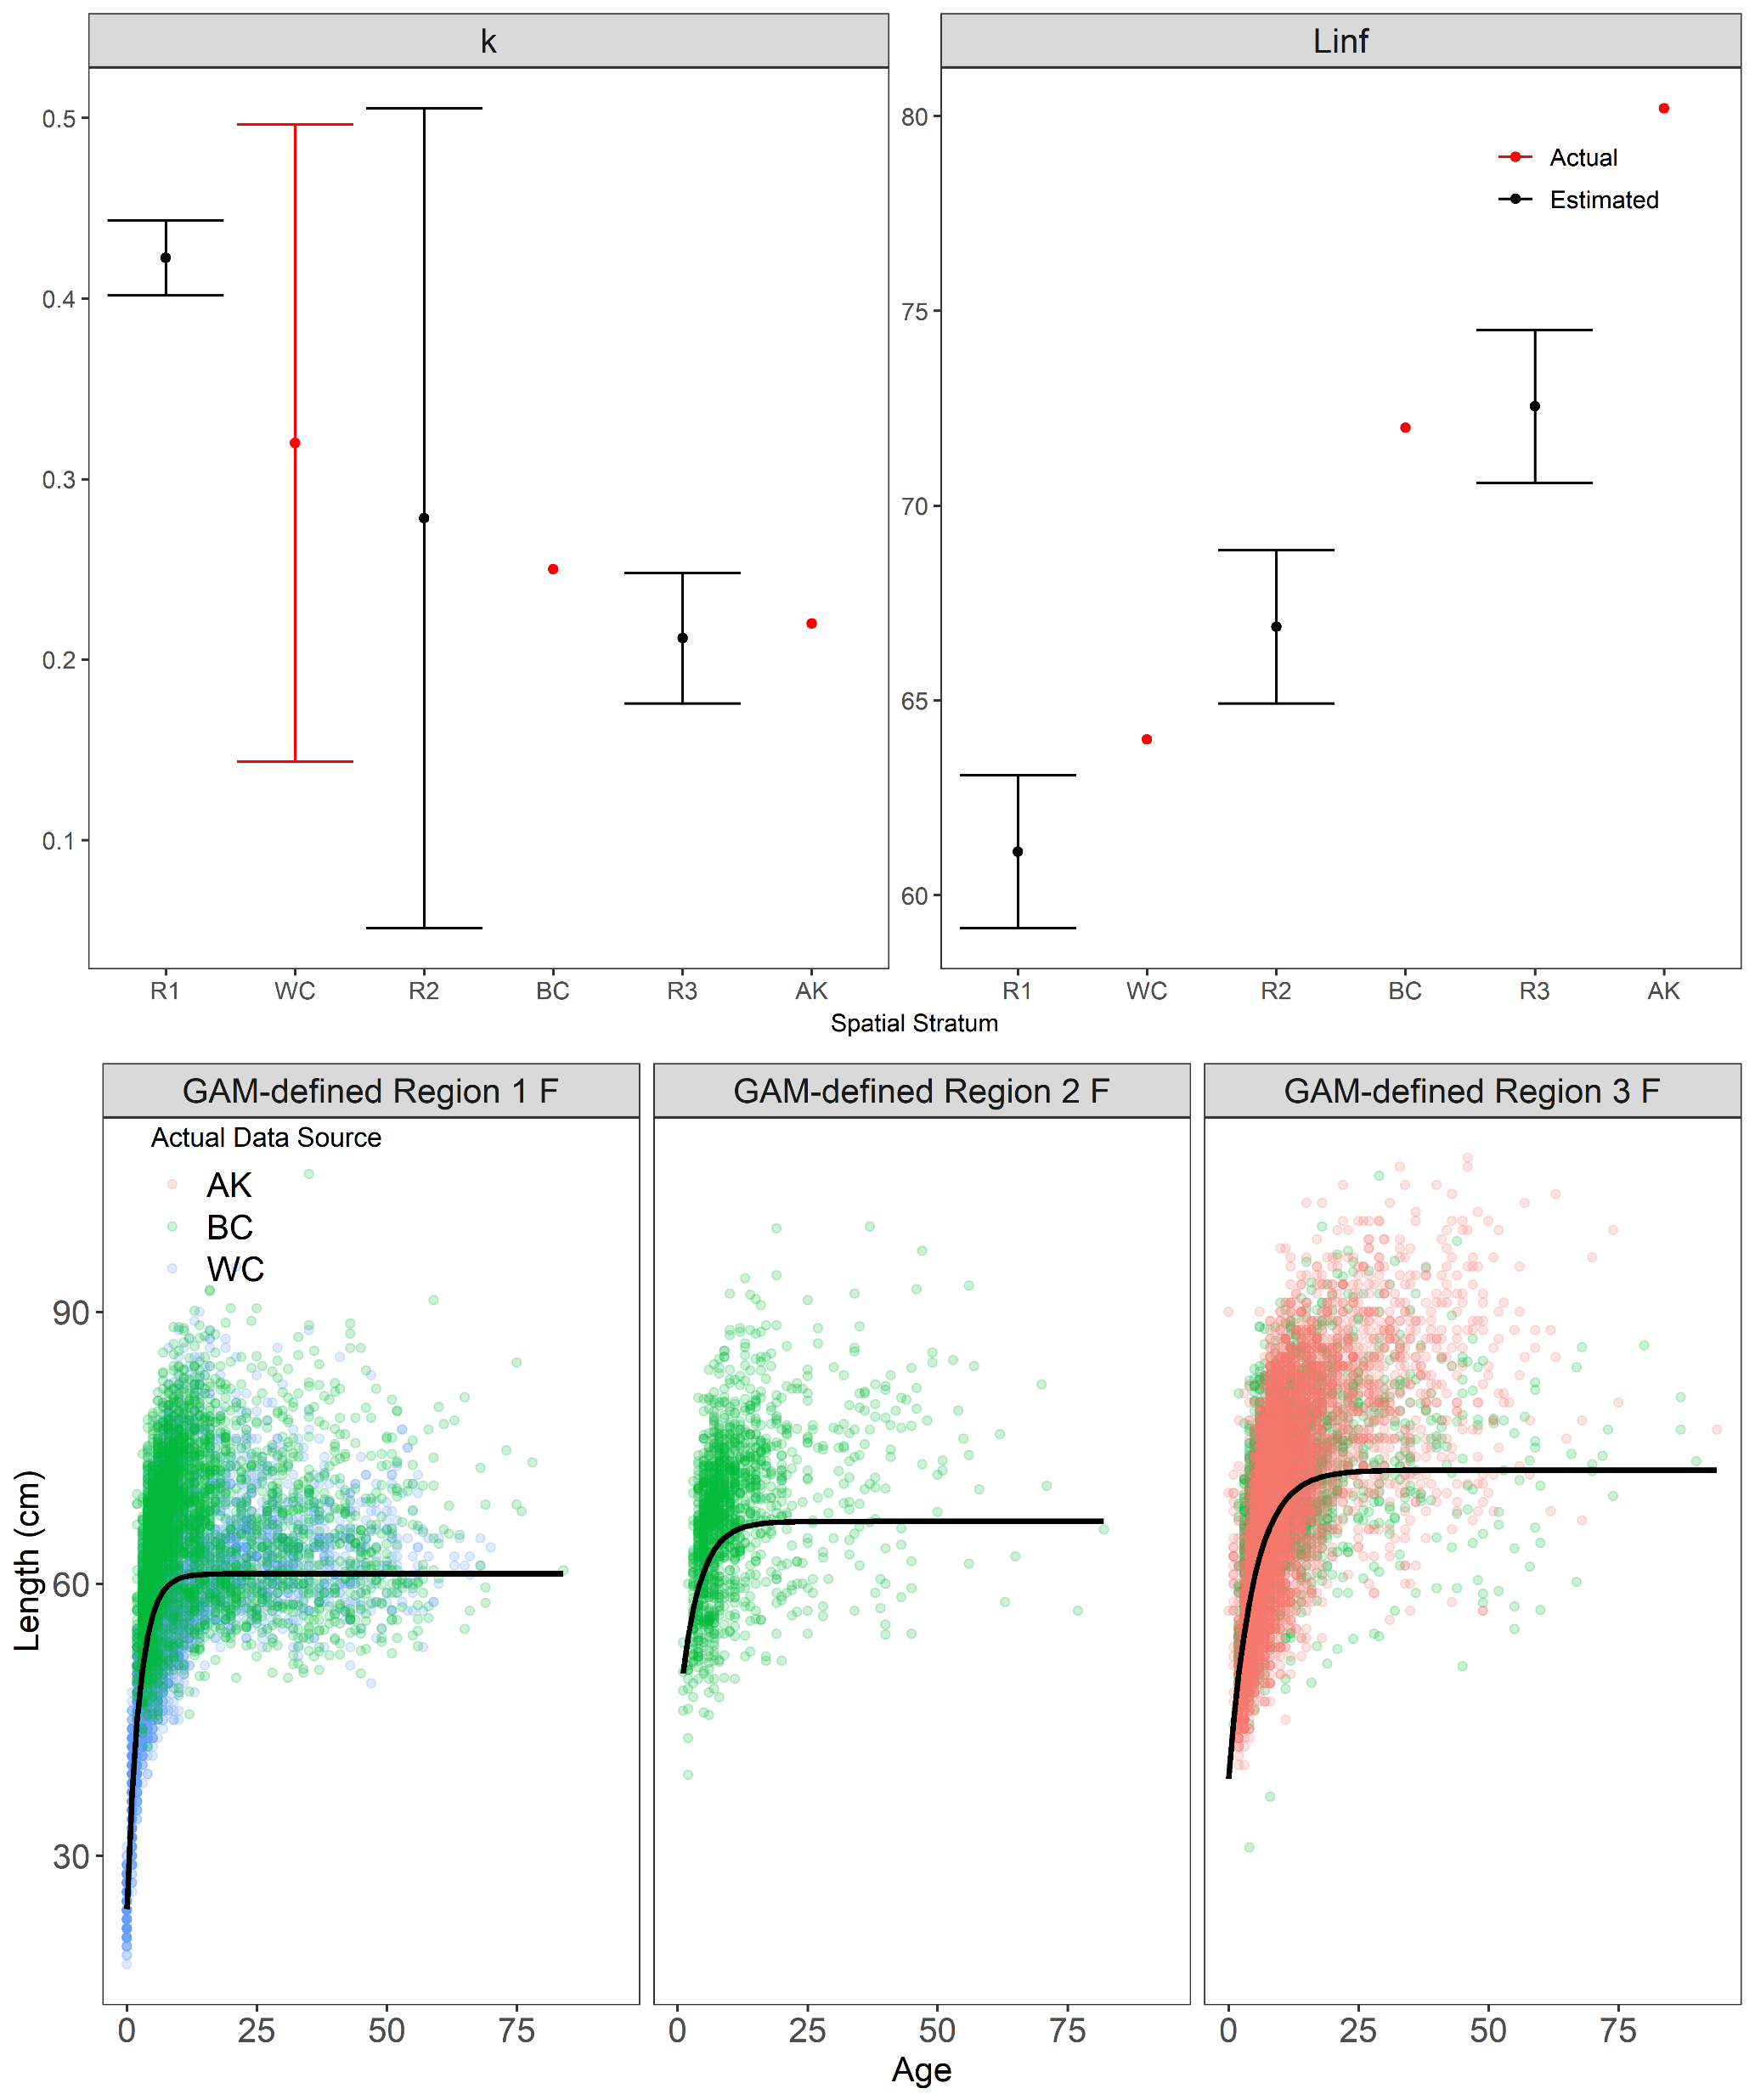
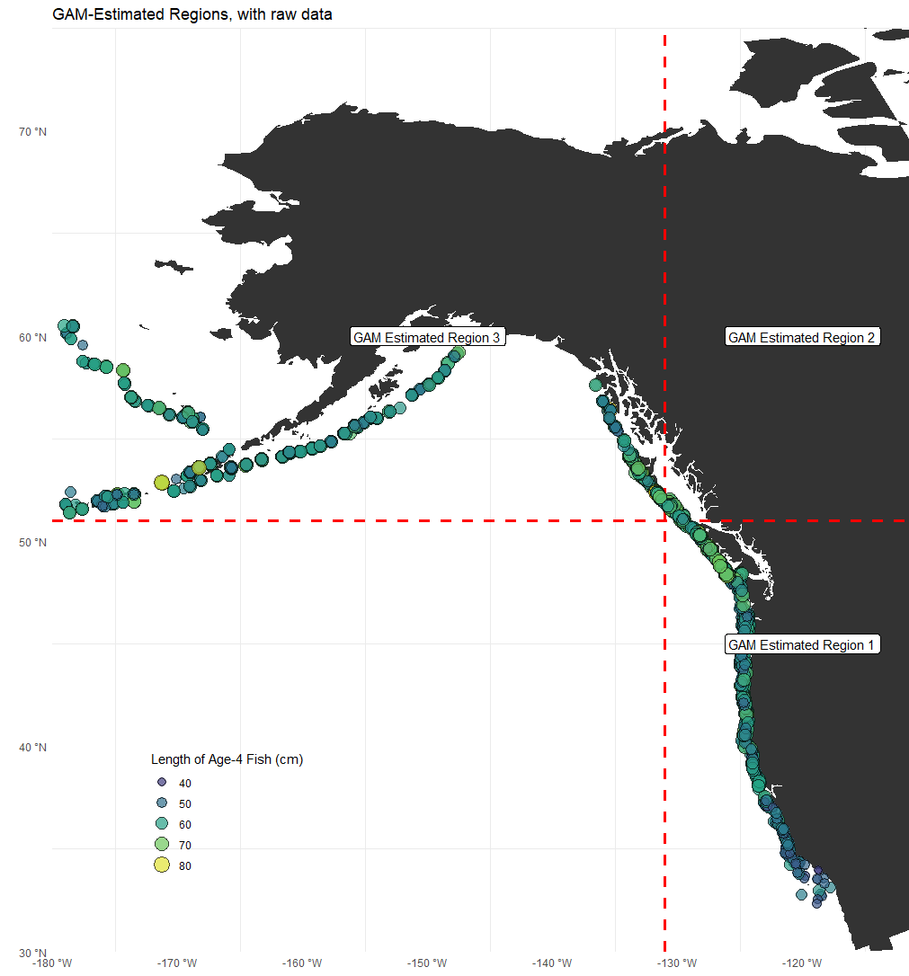
Application to Sablefish
Potential ecosystem split

Slide 13
Next Steps
Finalize performance testing of IBM
Consider creating another E/W split on SAB data – where should this be?
Update with new WC ages, once available

